Slide 1
Lecture 16: Object Detection

Slide 2
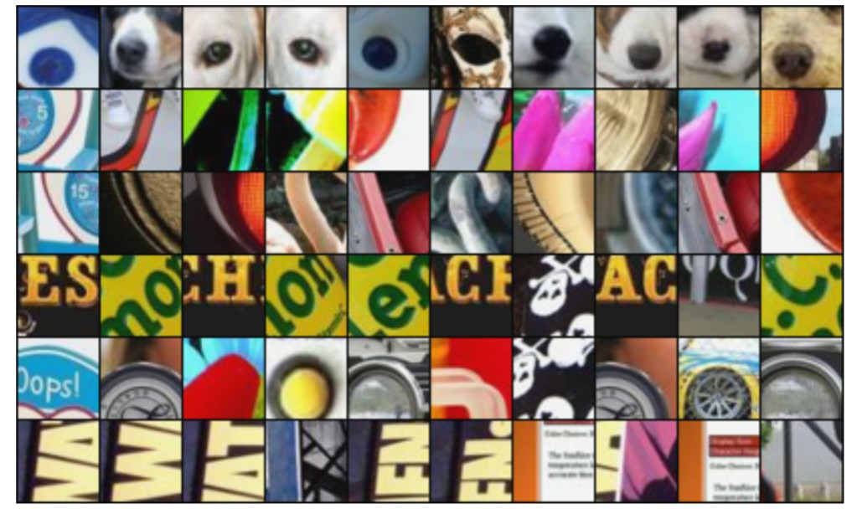
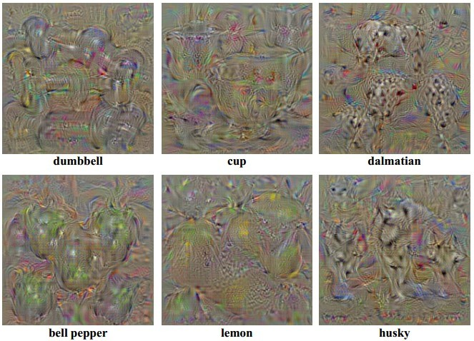
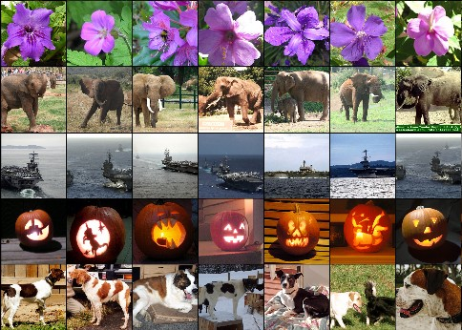
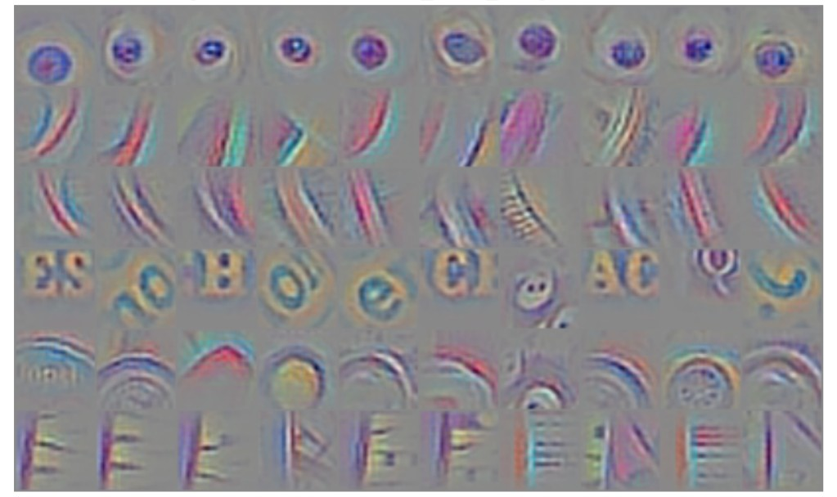
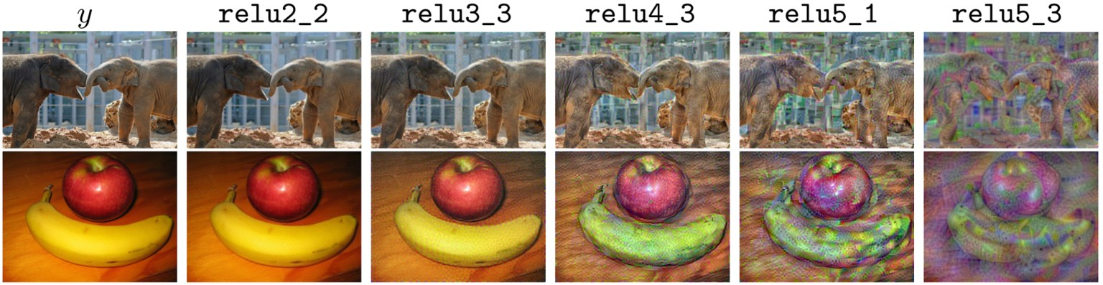
Last Time: Visualizing and Understanding CNNs
Maximally Activating Patches
Synthetic Images via Gradient Ascent
Nearest Neighbor
Feature Inversion
(Guided) Backprop

Slide 3
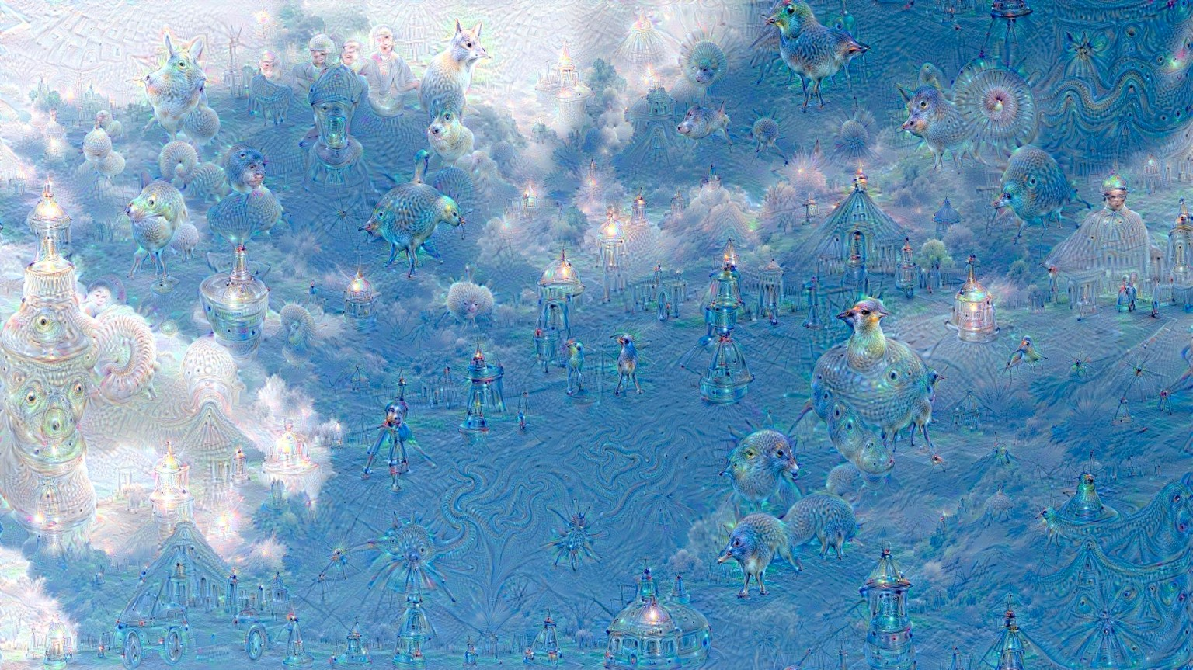
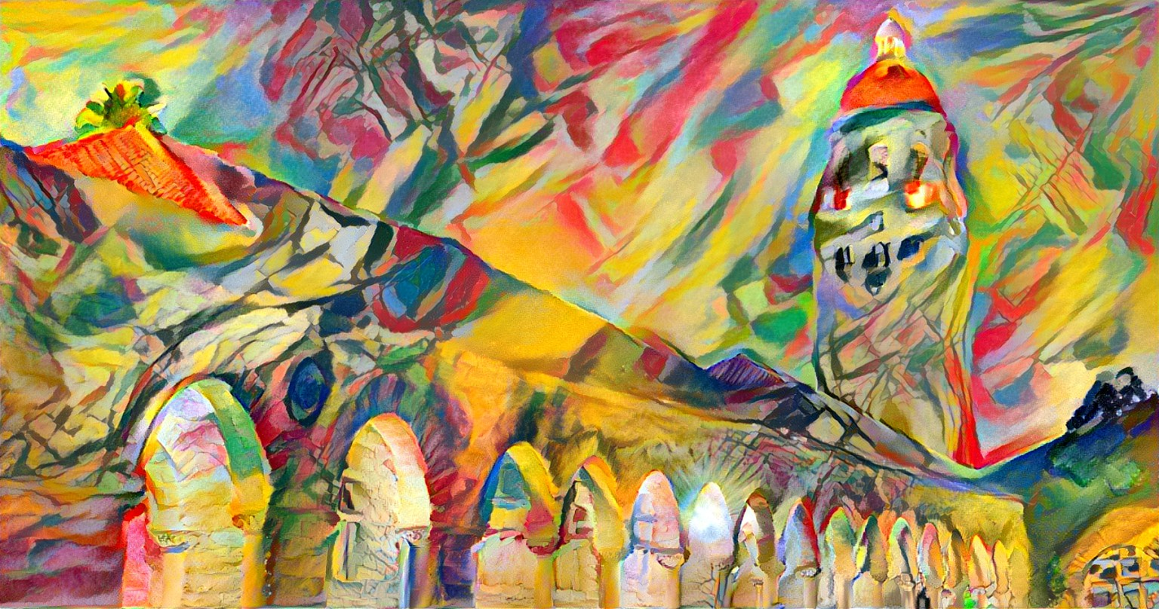
Last Time: Making art with CNNs
Style Transfer
DeepDream

Slide 4
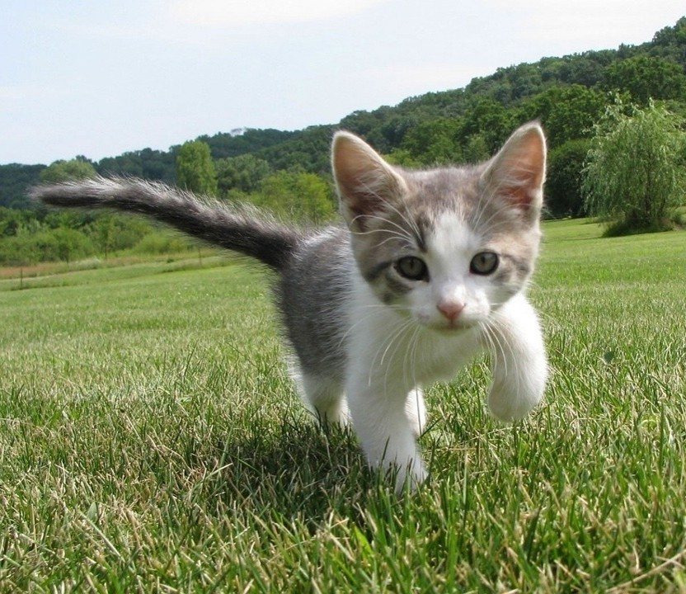
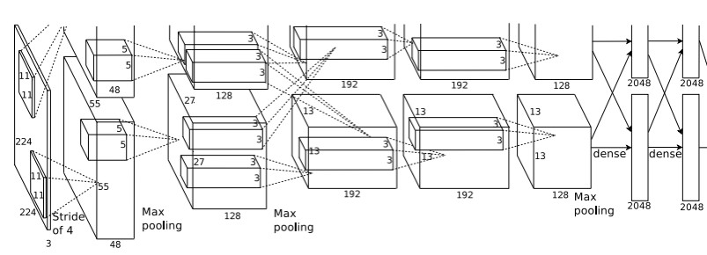
So far: Image Classification
Class Scores Cat: 0.9 Dog: 0.05 Car: 0.01
...
Fully-Connected: 4096 to 1000
Vector:
4096
This image is CC0 public domain
Figure copyright Alex Krizhevsky, Ilya Sutskever, and Geoffrey Hinton, 2012. Reproduced with permission.

Slide 5
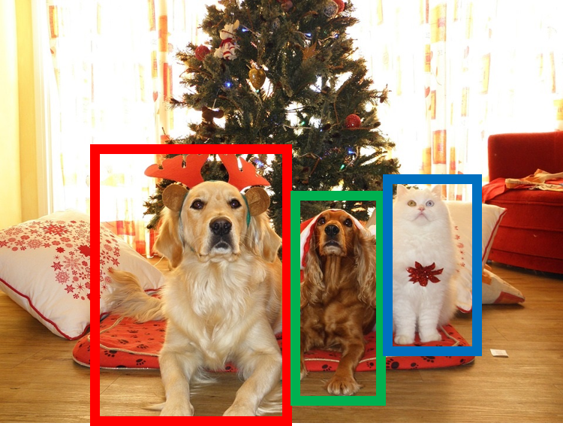
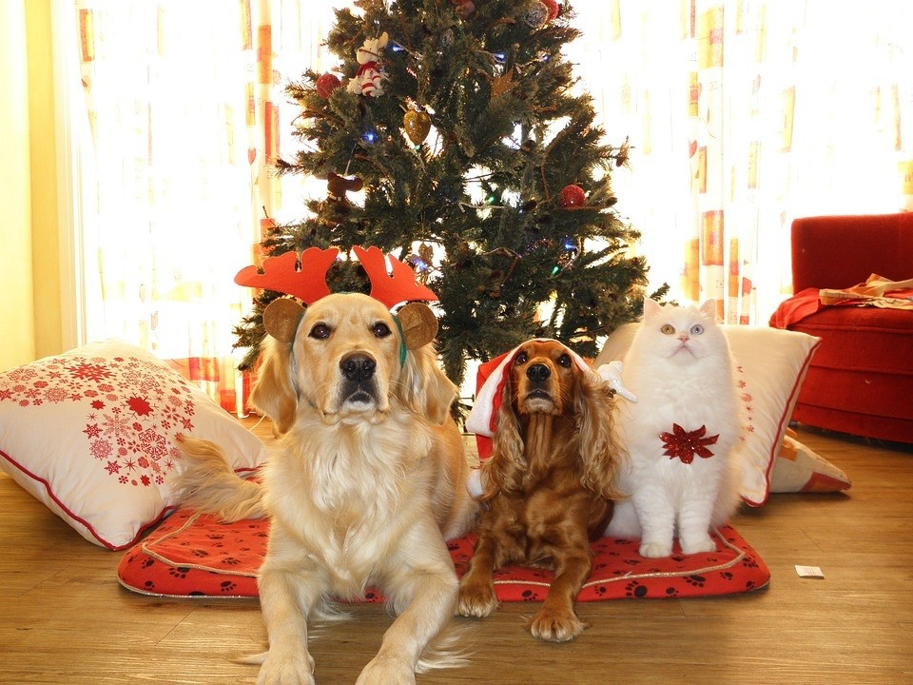
Computer Vision Tasks
Semantic Segmentation
Object Detection
Instance Segmentation
Classification
CAT
GRASS, CAT, TREE, SKY
DOG, DOG, CAT
DOG, DOG, CAT
No spatial extent
No objects, just pixels
Multiple Objects
This image is CC0 public domain

Slide 6
Today: Object Detection
Classification ^{Semantic} Segmentation
_{CAT} GRASS, CAT, TREE, SKY
No spatial extent No objects, just pixels
Instance Segmentation
DOG, DOG, CAT
Object Detection
DOG, DOG, CAT
Multiple Objects
This image is CC0 public domain

Slide 7
Object Detection: Task Definition
Input: Single RGB Image
Output: A set of detected objects; For each object predict:
Category label (from fixed, known set of categories)
Bounding box (four numbers: x, y, width, height)

Slide 8
Object Detection: Challenges
Multiple outputs: Need to output variable numbers of objects per image
Multiple types of output: Need to predict ”what” (category label) as well as “where” (bounding box)
Large images: Classification works at 224x224; need higher resolution for
detection, often ~800x600

Slide 9
Detecting a single object
Vector:
4096
This image is CC0 public domain
Lecture 15 - 10

Slide 10
Detecting a single object
“What”
Class Scores Cat: 0.9 Dog: 0.05 Car: 0.01
...
Correct label:
Cat
Fully Connected: 4096 to 1000
Softmax Loss
Vector:
4096
This image is CC0 public domain

Slide 11
Detecting a single object
“What”
Class Scores Cat: 0.9 Dog: 0.05 Car: 0.01
...
Correct label:
Cat
Fully Connected: 4096 to 1000
Softmax Loss
Vector:
4096
This image is CC0 public domain
Fully Connected: 4096 to 4
Treat localization as a regression problem!
Box Coordinates (x, y, w, h)
L2 Loss
“Where”
Correct box: (x’, y’, w’, h’)

Slide 12
Detecting a single object
“What”
Class Scores Cat: 0.9 Dog: 0.05 Car: 0.01
...
Correct label:
Cat
Fully Connected: 4096 to 1000
Softmax Loss
Weighted Sum
Loss
Vector:
4096
This image is CC0 public domain
Fully Connected: 4096 to 4
Treat localization as a regression problem!
Box Coordinates (x, y, w, h)
L2 Loss
“Where”
Correct box: (x’, y’, w’, h’)

Slide 13
Detecting a single object
“What”
Class Scores Cat: 0.9 Dog: 0.05 Car: 0.01
...
Correct label:
Cat
Fully Connected: 4096 to 1000
Softmax Loss
Multitask Loss
Loss
Weighted Sum
Vector:
4096
This image is CC0 public domain
Fully Connected: 4096 to 4
Treat localization as a regression problem!
Box Coordinates (x, y, w, h)
L2 Loss
“Where”
Correct box: (x’, y’, w’, h’)

Slide 14
Detecting a single object
“What”
Class Scores Cat: 0.9 Dog: 0.05 Car: 0.01
...
Correct label:
Cat
Fully Connected: 4096 to 1000
Softmax Loss
Often pretrained on ImageNet (Transfer learning)
Multitask Loss
Loss
Weighted Sum
Vector:
4096
This image is CC0 public domain
Fully Connected: 4096 to 4
Treat localization as a regression problem!
Box Coordinates (x, y, w, h)
L2 Loss
“Where”
Correct box: (x’, y’, w’, h’)

Slide 15
Detecting a single object
“What”
Class Scores Cat: 0.9 Dog: 0.05 Car: 0.01
...
Correct label:
Cat
Fully Connected: 4096 to 1000
Softmax Loss
Often pretrained on ImageNet (Transfer learning)
Multitask Loss
Loss
Weighted Sum
Vector:
4096
This image is CC0 public domain
Fully Connected: 4096 to 4
Treat localization as a regression problem!
Box Coordinates (x, y, w, h)
L2 Loss
Problem: Images can have more than one object!
“Where”
Correct box: (x’, y’, w’, h’)

Slide 16

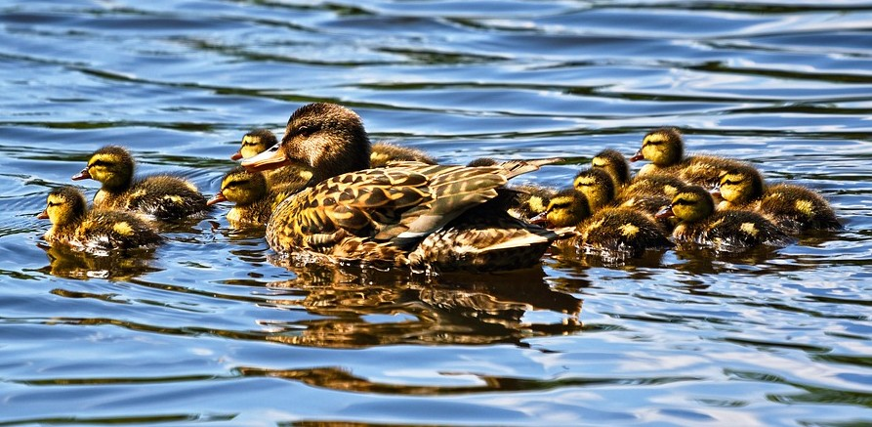
Need different numbers
Detecting Multiple Objects
of outputs per image
CAT: (x, y, w, h)
4 numbers
DOG: (x, y, w, h)
DOG: (x, y, w, h)
CAT: (x, y, w, h)
16 numbers
DUCK: (x, y, w, h)
DUCK: (x, y, w, h)
….
Many numbers!
Duck image is free to use under the Pixabay license

Slide 17
Detecting Multiple Objects: Sliding Window
Apply a CNN to many different crops of the image, CNN classifies each crop as object or background
Dog? NO Cat? NO
Background? YES

Slide 18
Detecting Multiple Objects: Sliding Window
Apply a CNN to many different crops of the image, CNN classifies each crop as object or background
Dog? YES
Cat? NO Background? NO

Slide 19
Detecting Multiple Objects: Sliding Window
Apply a CNN to many different crops of the image, CNN classifies each crop as object or background
Dog? YES
Cat? NO Background? NO
Lecture 15 - 20

Slide 20
Detecting Multiple Objects: Sliding Window
Apply a CNN to many different crops of the image, CNN classifies each crop as object or background
Dog? NO Cat? YES
Background? NO

Slide 21
Detecting Multiple Objects: Sliding Window
Apply a CNN to many different crops of the image, CNN classifies each crop as object or background
Question: How many possible boxes are there in an image of size H x W?

Slide 22
Detecting Multiple Objects: Sliding Window
Apply a CNN to many different crops of the image, CNN classifies each crop as object or background
Question: How many possible boxes are there in an image of size H x W?
Consider a box of size h x w: Possible x positions: W – w + 1 Possible y positions: H – h + 1 Possible positions:
(W – w + 1) * (H – h + 1)

Slide 23
Detecting Multiple Objects: Sliding Window
Apply a CNN to many different crops of the image, CNN classifies each crop as object or background
Question: How many possible boxes are there in an image of size H x W?
Total possible boxes:
/ +
! !(𝑊 − 𝑤 + 1)(𝐻 − ℎ + 1)
0-. ,-.
Consider a box of size h x w: Possible x positions: W – w + 1 Possible y positions: H – h + 1 Possible positions:
(W – w + 1) * (H – h + 1)
𝐻(𝐻 + 1) 𝑊(𝑊 + 1)
2 2
=

Slide 24
Detecting Multiple Objects: Sliding Window
800 x 600 image has ~58M boxes! No way we can evaluate them all
Apply a CNN to many different crops of the image, CNN classifies each crop as object or background
Question: How many possible boxes are there in an image of size H x W?
Total possible boxes:
/ +
! !(𝑊 − 𝑤 + 1)(𝐻 − ℎ + 1)
0-. ,-.
Consider a box of size h x w: Possible x positions: W – w + 1 Possible y positions: H – h + 1 Possible positions:
(W – w + 1) * (H – h + 1)
𝐻(𝐻 + 1) 𝑊(𝑊 + 1)
2 2
=

Slide 25
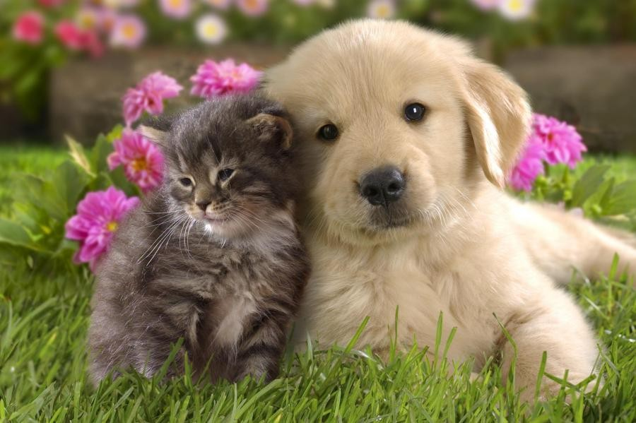
Region Proposals
Find a small set of boxes that are likely to cover all objects
Often based on heuristics: e.g. look for “blob-like” image regions
Relatively fast to run; e.g. Selective Search gives 2000 region proposals in a few seconds on CPU
Alexe et al, “Measuring the objectness of image windows”, TPAMI 2012 Uijlings et al, “Selective Search for Object Recognition”, IJCV 2013 Cheng et al, “BING: Binarized normed gradients for objectness estimation at 300fps”, CVPR 2014 Zitnick and Dollar, “Edge boxes: Locating object proposals from edges”, ECCV 2014

Slide 26

R-CNN: Region-Based CNN
Input image
Girshick et al, “Rich feature hierarchies for accurate object detection and semantic segmentation”, CVPR 2014.
Figure copyright Ross Girshick, 2015; source. Reproduced with permission.

Slide 27
R-CNN: Region-Based CNN
Regions of Interest (RoI) from a proposal method (~2k)
Lecture 15 - 27
Input image
Girshick et al, “Rich feature hierarchies for accurate object detection and semantic segmentation”, CVPR 2014.
Figure copyright Ross Girshick, 2015; source. Reproduced with permission.

Slide 28
R-CNN: Region-Based CNN
Warped image regions (224x224)
Regions of Interest (RoI) from a proposal method (~2k)
Lecture 15 - 28
Input image
Girshick et al, “Rich feature hierarchies for accurate object detection and semantic segmentation”, CVPR 2014.
Figure copyright Ross Girshick, 2015; source. Reproduced with permission.

Slide 29
R-CNN: Region-Based CNN
Conv Net
Forward each region through ConvNet
Conv Net
Conv Net
Warped image regions (224x224)
Regions of Interest (RoI) from a proposal method (~2k)
Lecture 15 - 30
Input image
Girshick et al, “Rich feature hierarchies for accurate object detection and semantic segmentation”, CVPR 2014.
Figure copyright Ross Girshick, 2015; source. Reproduced with permission.

Slide 30
R-CNN: Region-Based CNN
Classify each region
Class
Class
Class
Conv Net
Forward each region through ConvNet
Conv Net
Conv Net
Warped image regions (224x224)
Regions of Interest (RoI) from a proposal method (~2k)
Lecture 15 - 30
Input image
Girshick et al, “Rich feature hierarchies for accurate object detection and semantic segmentation”, CVPR 2014.
Figure copyright Ross Girshick, 2015; source. Reproduced with permission.

Slide 31
R-CNN: Region-Based CNN
Classify each region
Bounding box regression: Predict “transform” to correct the RoI: 4 numbers (t_{x}, t_{y}, t_{h}, t_{w})
Bbox
Class
Bbox Class
Bbox
Class
Conv Net
Forward each region through ConvNet
Conv Net
Conv Net
Warped image regions (224x224)
Regions of Interest (RoI) from a proposal method (~2k)
Lecture 15 - 31
Input image
Girshick et al, “Rich feature hierarchies for accurate object detection and semantic segmentation”, CVPR 2014.
Figure copyright Ross Girshick, 2015; source. Reproduced with permission.

Slide 32
R-CNN: Region-Based CNN
Classify each region
Bounding box regression: Predict “transform” to correct the RoI: 4 numbers (t_{x}, t_{y}, t_{h}, t_{w})
Bbox
Class
Bbox Class
Bbox
Class
Conv Net
Forward each region through ConvNet
Region proposal: (p_{x}, p_{y}, p_{h}, p_{w}) Transform: (t_{x}, t_{y}, t_{h}, t_{w}) Output box: (b_{x}, b_{y}, b_{h}, b_{w})
Translate relative to box size: b_{x} = p_{x} + p_{w}t_{x} b_{y} = p_{y} + p_{h}t_{y}
Log-space scale transform:
Conv Net
Conv Net
Warped image regions (224x224)
Regions of
Input image
Interest (RoI) from a proposal method (~2k)
Lecture 15 - 33
b = p exp(t )
b
= p exp(t )
w
w
w
h
h
h
Girshick et al, “Rich feature hierarchies for accurate object detection and semantic segmentation”, CVPR 2014.
Figure copyright Ross Girshick, 2015; source. Reproduced with permission.

Slide 33
R-CNN: Test-time
Input: Single RGB Image
Bbox
Class
Run region proposal method to compute ~2000 region proposals
Resize each region to 224x224 and run independently through CNN to predict
class scores and bbox transform
Use scores to select a subset of region proposals to output
(Many choices here: threshold on
background, or per-category? Or take top K proposals per image?)
Compare with ground-truth boxes
Bbox Class
Bbox
Class
Conv Net
Conv Net
Conv Net
Input image
Girshick et al, “Rich feature hierarchies for accurate object detection and
semantic segmentation”, CVPR 2014.
Figure copyright Ross Girshick, 2015; source. Reproduced with permission.
Lecture 15 - 34

Slide 34
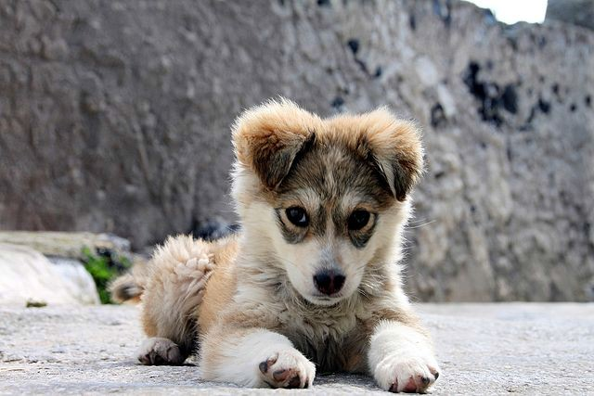
Comparing Boxes: Intersection over Union (IoU)
How can we compare our prediction to the ground-truth box?
Our Prediction
Ground Truth
Puppy image is licensed under CC-A 2.0 Generic license. Bounding boxes and text added by Justin Johnson.

Slide 35
Comparing Boxes: Intersection over Union (IoU)
How can we compare our prediction to the ground-truth box?
Intersection over Union (IoU) (Also called “Jaccard similarity” or “Jaccard index”):
𝑨𝒓𝒆𝒂 𝒐𝒇 𝑰𝒏𝒕𝒆𝒓𝒔𝒆𝒄𝒕𝒊𝒐𝒏
𝑨𝒓𝒆𝒂 𝒐𝒇 𝑼𝒏𝒊𝒐𝒏
Our Prediction
Ground Truth
Puppy image is licensed under CC-A 2.0 Generic license. Bounding boxes and text added by Justin Johnson.

Slide 36
Comparing Boxes: Intersection over Union (IoU)
How can we compare our prediction to the ground-truth box?
Intersection over Union (IoU) (Also called “Jaccard similarity” or “Jaccard index”):
𝑨𝒓𝒆𝒂 𝒐𝒇 𝑰𝒏𝒕𝒆𝒓𝒔𝒆𝒄𝒕𝒊𝒐𝒏
𝑨𝒓𝒆𝒂 𝒐𝒇 𝑼𝒏𝒊𝒐𝒏
IoU > 0.5 is “decent”
Our Prediction
Ground Truth
 | IoU = 0.54
Puppy image is licensed under CC-A 2.0 Generic license. Bounding boxes and text added by Justin Johnson.

Slide 37
Comparing Boxes: Intersection over Union (IoU)
How can we compare our prediction to the ground-truth box?
Intersection over Union (IoU) (Also called “Jaccard similarity” or “Jaccard index”):
𝑨𝒓𝒆𝒂 𝒐𝒇 𝑰𝒏𝒕𝒆𝒓𝒔𝒆𝒄𝒕𝒊𝒐𝒏
𝑨𝒓𝒆𝒂 𝒐𝒇 𝑼𝒏𝒊𝒐𝒏
IoU > 0.5 is “decent”, IoU > 0.7 is “pretty good”,
Our Prediction
Ground Truth
 | IoU = 0.71
Puppy image is licensed under CC-A 2.0 Generic license. Bounding boxes and text added by Justin Johnson.

Slide 38
Comparing Boxes: Intersection over Union (IoU)
How can we compare our prediction to the ground-truth box?
Intersection over Union (IoU) (Also called “Jaccard similarity” or “Jaccard index”):
𝑨𝒓𝒆𝒂 𝒐𝒇 𝑰𝒏𝒕𝒆𝒓𝒔𝒆𝒄𝒕𝒊𝒐𝒏
𝑨𝒓𝒆𝒂 𝒐𝒇 𝑼𝒏𝒊𝒐𝒏
IoU > 0.5 is “decent”, IoU > 0.7 is “pretty good”,
IoU > 0.9 is “almost perfect”
Our Prediction
Ground Truth
 | IoU = 0.91
Puppy image is licensed under CC-A 2.0 Generic license. Bounding boxes and text added by Justin Johnson.

Slide 39
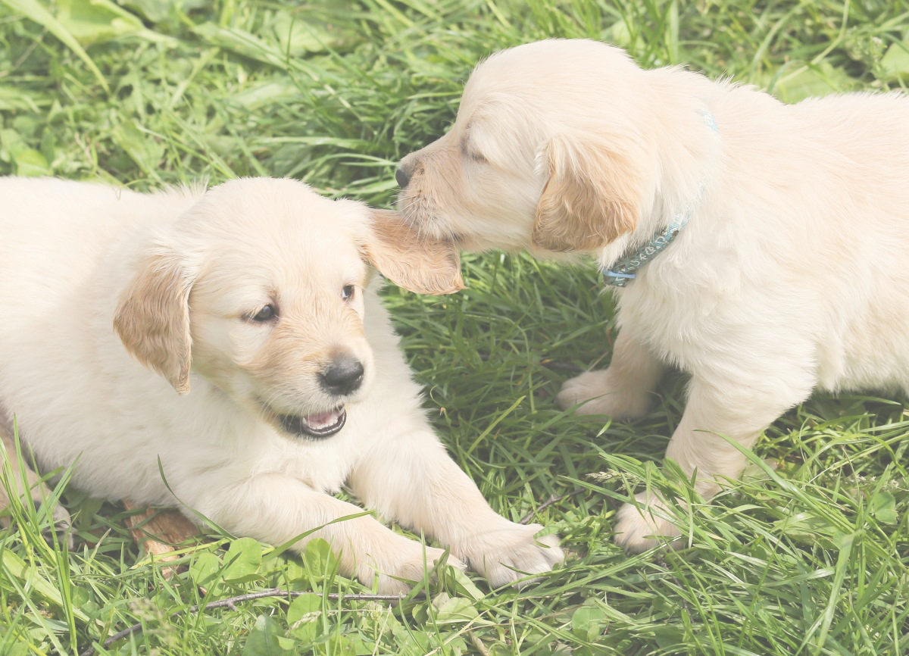
Overlapping Boxes
Problem: Object detectors often output many overlapping detections:
P(dog) = 0.75
P(dog) = 0.9
P(dog) = 0.7
P(dog) = 0.8
Puppy image is CC0 Public Domain

Slide 40
Overlapping Boxes: Non-Max Suppression (NMS)
Problem: Object detectors often output many overlapping detections:
P(dog) = 0.75
P(dog) = 0.9
Solution: Post-process raw detections using Non-Max Suppression (NMS)
Select next highest-scoring box
Eliminate lower-scoring boxes with IoU > threshold (e.g. 0.7)
If any boxes remain, GOTO 1
P(dog) = 0.7
P(dog) = 0.8
Puppy image is CC0 Public Domain

Slide 41
Overlapping Boxes: Non-Max Suppression (NMS)
Problem: Object detectors often output many overlapping detections:
P(dog) = 0.9
P(dog) = 0.75
Solution: Post-process raw detections using Non-Max Suppression (NMS)
Select next highest-scoring box
Eliminate lower-scoring boxes with IoU > threshold (e.g. 0.7)
If any boxes remain, GOTO 1
IoU(■, ■) = 0.78
IoU(■, ■) = 0.05
IoU(■, ■) = 0.07
P(dog) = 0.7
P(dog) = 0.8
Puppy image is CC0 Public Domain
Lecture 15 - 42

Slide 42
Overlapping Boxes: Non-Max Suppression (NMS)
Problem: Object detectors often output many overlapping detections:
P(dog) = 0.75
P(dog) = 0.9
Solution: Post-process raw detections using Non-Max Suppression (NMS)
Select next highest-scoring box
Eliminate lower-scoring boxes with IoU > threshold (e.g. 0.7)
If any boxes remain, GOTO 1
P(dog) = 0.7
IoU(■, ■) = 0.74
Puppy image is CC0 Public Domain

Slide 43
Overlapping Boxes: Non-Max Suppression (NMS)
Problem: Object detectors often output many overlapping detections:
P(dog) = 0.75
P(dog) = 0.9
Solution: Post-process raw detections using Non-Max Suppression (NMS)
Select next highest-scoring box
Eliminate lower-scoring boxes with IoU > threshold (e.g. 0.7)
If any boxes remain, GOTO 1
Puppy image is CC0 Public Domain

Slide 44

Overlapping Boxes: Non-Max Suppression (NMS)
Problem: Object detectors often output many overlapping detections:
Solution: Post-process raw detections using Non-Max Suppression (NMS)
Select next highest-scoring box
Eliminate lower-scoring boxes with IoU > threshold (e.g. 0.7)
If any boxes remain, GOTO 1
Problem: NMS may eliminate ”good” boxes when objects are highly overlapping… no good solution =(
Crowd image is free for commercial use under the Pixabay license

Slide 45
Evaluating Object Detectors: Mean Average Precision (mAP)
Run object detector on all test images (with NMS)
For each category, compute Average Precision (AP) = area under Precision vs Recall Curve

Slide 46
Evaluating Object Detectors: Mean Average Precision (mAP)
All dog detections sorted by score
0.99 0.95 0.90
0.5
0.10
Run object detector on all test images (with NMS)
For each category, compute Average Precision (AP) = area under Precision vs Recall Curve
For each detection (highest score to lowest score)
All ground-truth dog boxes

Slide 47
Evaluating Object Detectors: Mean Average Precision (mAP)
All dog detections sorted by score
0.99 0.95 0.90
0.5
0.10
Match: IoU > 0.5
Run object detector on all test images (with NMS)
For each category, compute Average Precision (AP) = area under Precision vs Recall Curve
For each detection (highest score to lowest score)
If it matches some GT box with IoU > 0.5, mark it as positive and eliminate the GT
Otherwise mark it as negative
All ground-truth dog boxes

Slide 48
Evaluating Object Detectors: Mean Average Precision (mAP)
All dog detections sorted by score
0.99 0.95 0.90
0.5
0.10
Match: IoU > 0.5
Run object detector on all test images (with NMS)
For each category, compute Average Precision (AP) = area under Precision vs Recall Curve
For each detection (highest score to lowest score)
If it matches some GT box with IoU > 0.5, mark it as positive and eliminate the GT
Otherwise mark it as negative
Plot a point on PR Curve
All ground-truth dog boxes
Precision = 1/1 = 1.0 Recall = 1/3 = 0.33
Precision
Recall
1.0
November 6, 2019

Slide 49
Evaluating Object Detectors: Mean Average Precision (mAP)
All dog detections sorted by score
0.99 0.95 0.90
0.5
0.10
Match: IoU > 0.5
Run object detector on all test images (with NMS)
For each category, compute Average Precision (AP) = area under Precision vs Recall Curve
For each detection (highest score to lowest score)
If it matches some GT box with IoU > 0.5, mark it as positive and eliminate the GT
Otherwise mark it as negative
Plot a point on PR Curve
All ground-truth dog boxes
Precision = 2/2 = 1.0 Recall = 2/3 = 0.67
Precision
Recall
1.0
November 6, 2019

Slide 50
Evaluating Object Detectors: Mean Average Precision (mAP)
All dog detections sorted by score
0.99 0.95 0.90
0.5
0.10
No match > 0.5 IoU with GT
Run object detector on all test images (with NMS)
For each category, compute Average Precision (AP) = area under Precision vs Recall Curve
For each detection (highest score to lowest score)
If it matches some GT box with IoU > 0.5, mark it as positive and eliminate the GT
Otherwise mark it as negative
Plot a point on PR Curve
All ground-truth dog boxes
Precision = 2/3 = 0.67 Recall = 2/3 = 0.67
Precision
Recall
1.0
November 6, 2019

Slide 51
Evaluating Object Detectors: Mean Average Precision (mAP)
All dog detections sorted by score
0.99 0.95 0.90
0.5 0.10
No match > 0.5 IoU with GT
Run object detector on all test images (with NMS)
For each category, compute Average Precision (AP) = area under Precision vs Recall Curve
For each detection (highest score to lowest score)
If it matches some GT box with IoU > 0.5, mark it as positive and eliminate the GT
Otherwise mark it as negative
Plot a point on PR Curve
All ground-truth dog boxes
Precision = 2/4 = 0.5 Recall = 2/3 = 0.67
Precision
Recall
1.0
November 6, 2019

Slide 52
Evaluating Object Detectors: Mean Average Precision (mAP)
All dog detections sorted by score
0.99 0.95 0.90
0.5
0.10
Match: > 0.5 IoU
Run object detector on all test images (with NMS)
For each category, compute Average Precision (AP) = area under Precision vs Recall Curve
For each detection (highest score to lowest score)
If it matches some GT box with IoU > 0.5, mark it as positive and eliminate the GT
Otherwise mark it as negative
Plot a point on PR Curve
All ground-truth dog boxes
Precision = 3/5 = 0.6 Recall = 3/3 = 1.0
Precision
Recall
1.0
November 6, 2019

Slide 53
Evaluating Object Detectors: Mean Average Precision (mAP)
All dog detections sorted by score
0.99 0.95 0.90
0.5
0.10
Run object detector on all test images (with NMS)
For each category, compute Average Precision (AP) = area under Precision vs Recall Curve
For each detection (highest score to lowest score)
If it matches some GT box with IoU > 0.5, mark it as positive and eliminate the GT
Otherwise mark it as negative
Plot a point on PR Curve
Average Precision (AP) = area under PR curve
All ground-truth dog boxes
Precision
Dog AP = 0.86
Recall
1.0
November 6, 2019

Slide 54
Evaluating Object Detectors: Mean Average Precision (mAP)
All dog detections sorted by score
0.99 0.95 0.90
0.5
0.10
Run object detector on all test images (with NMS)
For each category, compute Average Precision (AP) = area under Precision vs Recall Curve
For each detection (highest score to lowest score)
If it matches some GT box with IoU > 0.5, mark it as positive and eliminate the GT
Otherwise mark it as negative
Plot a point on PR Curve
Average Precision (AP) = area under PR curve
How to get AP = 1.0: Hit all GT boxes with IoU > 0.5, and have no “false positive” detections ranked above any “true positives”
All ground-truth dog boxes
Precision
Dog AP = 0.86
Recall
1.0

Slide 55
Evaluating Object Detectors: Mean Average Precision (mAP)
Run object detector on all test images (with NMS)
For each category, compute Average Precision (AP) = area under Precision vs Recall Curve
For each detection (highest score to lowest score)
If it matches some GT box with IoU > 0.5, mark it as positive and eliminate the GT
Otherwise mark it as negative
Plot a point on PR Curve
Average Precision (AP) = area under PR curve
Mean Average Precision (mAP) = average of AP for each category
Car AP = 0.65 Cat AP = 0.80 Dog AP = 0.86
mAP@0.5 = 0.77

Slide 56
Evaluating Object Detectors: Mean Average Precision (mAP)
Run object detector on all test images (with NMS)
For each category, compute Average Precision (AP) = area under Precision vs Recall Curve
For each detection (highest score to lowest score)
If it matches some GT box with IoU > 0.5, mark it as positive and eliminate the GT
Otherwise mark it as negative
Plot a point on PR Curve
Average Precision (AP) = area under PR curve
Mean Average Precision (mAP) = average of AP for each category
For “COCO mAP”: Compute mAP@thresh for each IoU threshold (0.5, 0.55, 0.6, …, 0.95) and take average
mAP@0.5 = 0.77 mAP@0.55 = 0.71 mAP@0.60 = 0.65
…
mAP@0.95 = 0.2
COCO mAP = 0.4

Slide 57
R-CNN: Region-Based CNN
Classify each region
Bounding box regression: Predict “transform” to correct the RoI: 4 numbers (t_{x}, t_{y}, t_{h}, t_{w})
Bbox
Class
Bbox Class
Bbox
Class
Conv Net
Forward each region through ConvNet
Conv Net
Conv Net
Warped image regions (224x224)
Regions of Interest (RoI) from a proposal method (~2k)
Lecture 15 - 57
Input image
Girshick et al, “Rich feature hierarchies for accurate object detection and semantic segmentation”, CVPR 2014.
Figure copyright Ross Girshick, 2015; source. Reproduced with permission.

Slide 58
R-CNN: Region-Based CNN
Classify each region
Bounding box regression: Predict “transform” to correct the RoI: 4 numbers (t_{x}, t_{y}, t_{h}, t_{w})
Bbox
Class
Bbox Class
Bbox
Class
Conv Net
Forward each region through ConvNet
Problem: Very slow! Need to do ~2k forward passes for each image!
Conv Net
Conv Net
Warped image regions (224x224)
Regions of Interest (RoI) from a proposal method (~2k)
Lecture 15 - 58
Input image
Girshick et al, “Rich feature hierarchies for accurate object detection and semantic segmentation”, CVPR 2014.
Figure copyright Ross Girshick, 2015; source. Reproduced with permission.

Slide 59
R-CNN: Region-Based CNN
Classify each region
Bounding box regression: Predict “transform” to correct the RoI: 4 numbers (t_{x}, t_{y}, t_{h}, t_{w})
Bbox
Class
Bbox Class
Bbox
Class
Conv Net
Forward each region through ConvNet
Problem: Very slow! Need to do ~2k forward passes for each image!
Conv Net
Conv Net
Warped image regions (224x224)
Solution: Run CNN
*before* warping!
Regions of Interest (RoI) from a proposal method (~2k)
Input image
Girshick et al, “Rich feature hierarchies for accurate object detection and semantic segmentation”, CVPR 2014.
Figure copyright Ross Girshick, 2015; source. Reproduced with permission.

Slide 60

“Slow” R-CNN Process each region independently
Bbox
Class
Bbox
Class
Bbox
Class
Conv Net
Conv Net
Conv Net
Input image

Slide 61

Fast R-CNN
“Slow” R-CNN Process each region independently
Bbox
Class
Bbox
Class
Bbox
Class
Conv Net
Conv Net
Conv Net
Input image
Input image
Girshick, “Fast R-CNN”, ICCV 2015. Figure copyright Ross Girshick, 2015; source. Reproduced with permission.

Slide 62
Fast R-CNN
“Slow” R-CNN Process each region independently
Bbox
Class
Bbox
Class
Bbox
Class
Image features
Run whole image through ConvNet
Conv Net
Conv Net
“Backbone” network: AlexNet, VGG,
Conv Net
ConvNet
ResNet, etc
Input image
Input image
Girshick, “Fast R-CNN”, ICCV 2015. Figure copyright Ross Girshick, 2015; source. Reproduced with permission.

Slide 63
Fast R-CNN
“Slow” R-CNN Process each region independently
Regions of Interest (RoIs) from a proposal method
Bbox
Class
Bbox
Class
Bbox
Class
Image features
Run whole image through ConvNet
Conv Net
Conv Net
“Backbone” network: AlexNet, VGG,
Conv Net
ConvNet
ResNet, etc
Input image
Input image
Girshick, “Fast R-CNN”, ICCV 2015. Figure copyright Ross Girshick, 2015; source. Reproduced with permission.

Slide 64
Fast R-CNN
“Slow” R-CNN Process each region independently
Regions of Interest (RoIs) from a proposal method
Bbox
Class
Bbox
Class
Crop + Resize features Image features
Run whole image through ConvNet
Bbox
Class
Conv Net
Conv Net
“Backbone” network: AlexNet, VGG,
Conv Net
ConvNet
ResNet, etc
Input image
Input image
Girshick, “Fast R-CNN”, ICCV 2015. Figure copyright Ross Girshick, 2015; source. Reproduced with permission.

Slide 65
Fast R-CNN
“Slow” R-CNN Process each region independently
Regions of Interest (RoIs) from a proposal method
Per-Region Network
CNN
CNN
CNN
Bbox
Class
Bbox
Class
Crop + Resize features Image features
Run whole image through ConvNet
Bbox
Class
Conv Net
Conv Net
“Backbone” network: AlexNet, VGG,
Conv Net
ConvNet
ResNet, etc
Input image
Input image
Girshick, “Fast R-CNN”, ICCV 2015. Figure copyright Ross Girshick, 2015; source. Reproduced with permission.

Slide 66
Fast R-CNN
Bbox
Bbox
Bbox
Category and box transform per region
“Slow” R-CNN
Class
Class
Class
Process each region independently
Regions of Interest (RoIs) from a proposal method
Per-Region Network
CNN
CNN
CNN
Bbox
Class
Bbox
Class
Crop + Resize features Image features
Run whole image through ConvNet
Bbox
Class
Conv Net
Conv Net
“Backbone” network: AlexNet, VGG,
Conv Net
ConvNet
ResNet, etc
Input image
Input image
Girshick, “Fast R-CNN”, ICCV 2015. Figure copyright Ross Girshick, 2015; source. Reproduced with permission.

Slide 67
Fast R-CNN
Bbox
Bbox
Bbox
Category and box transform per region
Class
Class
Class
Per-Region network is relatively lightweight
Regions of Interest (RoIs) from a proposal method
Per-Region Network
CNN
CNN
CNN
Crop + Resize features Image features
Run whole image through ConvNet
“Backbone” network: AlexNet, VGG, ResNet, etc
Most of the computation happens in backbone network; this saves work for overlapping region proposals
ConvNet
Input image
Girshick, “Fast R-CNN”, ICCV 2015. Figure copyright Ross Girshick, 2015; source. Reproduced with permission.

Slide 68
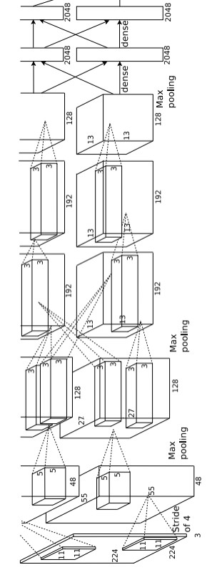
Fast R-CNN
Bbox
Bbox
Bbox
Category and box transform per region
Example: When using AlexNet for detection, five conv layers are used for backbone and two FC layers are used for per- region network
Class
Class
Class
Regions of Interest (RoIs) from a proposal method
Per-Region Network
CNN
CNN
CNN
Crop + Resize features Image features
“Backbone” network: AlexNet, VGG, ResNet, etc
Run whole image through ConvNet
ConvNet
Input image
Girshick, “Fast R-CNN”, ICCV 2015. Figure copyright Ross Girshick, 2015; source. Reproduced with permission.

Slide 69
Fast R-CNN
Softmax
FC 1000
Pool
Bbox
Bbox
Bbox
Category and box transform per region
3x3 conv, 512
3x3 conv, 512
Example:
For ResNet, last stage is used as per-region network; the rest of the network is used as backbone
Class
Class
Class
3x3 conv, 512
3x3 conv, 512
3x3 conv, 512
3x3 conv, 512, /2
Regions of Interest (RoIs) from a proposal method
Per-Region Network
CNN
CNN
CNN
..
.
Crop + Resize features Image features
3x3 conv, 128
3x3 conv, 128
3x3 conv, 128
3x3 conv, 128
3x3 conv, 128
3x3 conv, 128, / 2
“Backbone” network: AlexNet, VGG, ResNet, etc
Run whole image through ConvNet
3x3 conv, 64
3x3 conv, 64
3x3 conv, 64
3x3 conv, 64
ConvNet
3x3 conv, 64
3x3 conv, 64
Pool
7x7 conv, 64, / 2
Input
Input image
Girshick, “Fast R-CNN”, ICCV 2015. Figure copyright Ross Girshick, 2015; source. Reproduced with permission.
Lecture 15 - 70

Slide 70
Fast R-CNN
Bbox
Bbox
Bbox
Category and box transform per region
Class
Class
Class
Regions of Interest (RoIs) from a proposal method
Per-Region Network
CNN
CNN
CNN
Crop + Resize features Image features
How to crop features?
“Backbone” network: AlexNet, VGG, ResNet, etc
Run whole image through ConvNet
ConvNet
Input image
Girshick, “Fast R-CNN”, ICCV 2015. Figure copyright Ross Girshick, 2015; source. Reproduced with permission.
Lecture 15 - 71

Slide 71
Cropping Features: RoI Pool
Input Image (e.g. 3 x 640 x 480)
Girshick, “Fast R-CNN”, ICCV 2015.

Slide 72
Cropping Features: RoI Pool
CNN
Input Image (e.g. 3 x 640 x 480)
Image features (e.g. 512 x 20 x 15)
Girshick, “Fast R-CNN”, ICCV 2015.

Slide 73
Cropping Features: RoI Pool
Project proposal onto features
CNN
Input Image (e.g. 3 x 640 x 480)
Image features (e.g. 512 x 20 x 15)
Girshick, “Fast R-CNN”, ICCV 2015.

Slide 74
Cropping Features: RoI Pool
“Snap” to grid cells
Project proposal onto features
CNN
Input Image (e.g. 3 x 640 x 480)
Image features (e.g. 512 x 20 x 15)
Girshick, “Fast R-CNN”, ICCV 2015.

Slide 75
Cropping Features: RoI Pool
Divide into 2x2 grid of (roughly) equal subregions
“Snap” to grid cells
Project proposal onto features
CNN
Input Image (e.g. 3 x 640 x 480)
Image features (e.g. 512 x 20 x 15)
Girshick, “Fast R-CNN”, ICCV 2015.

Slide 76
Cropping Features: RoI Pool
Divide into 2x2 grid of (roughly) equal subregions
“Snap” to grid cells
Project proposal onto features
Max-pool within each subregion
CNN
Region features (here 512 x 2 x 2;
In practice e.g 512 x 7 x 7)
Input Image (e.g. 3 x 640 x 480)
Image features (e.g. 512 x 20 x 15)
Region features always the same size even if input regions have different sizes!
November 6, 2019
Girshick, “Fast R-CNN”, ICCV 2015.

Slide 77
Cropping Features: RoI Pool
Divide into 2x2 grid of (roughly) equal subregions
“Snap” to grid cells
Project proposal onto features
Max-pool within each subregion
CNN
Region features (here 512 x 2 x 2;
In practice e.g 512 x 7 x 7)
Input Image (e.g. 3 x 640 x 480)
Image features (e.g. 512 x 20 x 15)
Region features always the same size even if input regions have different sizes!
November 6, 2019
Girshick, “Fast R-CNN”, ICCV 2015.

Slide 78
Cropping Features: RoI Pool
Divide into 2x2 grid of (roughly) equal subregions
“Snap” to grid cells
Project proposal onto features
Max-pool within each subregion
CNN
Region features (here 512 x 2 x 2;
In practice e.g 512 x 7 x 7)
Input Image (e.g. 3 x 640 x 480)
Image features (e.g. 512 x 20 x 15)
Region features always the same size even if input regions have different sizes!
November 6, 2019
Problem: Slight misalignment due to snapping; different-sized subregions is weird
Lecture 15 - 79
Girshick, “Fast R-CNN”, ICCV 2015.

Slide 79
Cropping Features: RoI Align
Divide into equal-sized subregions (may not be aligned to grid!)
No “snapping”!
Project proposal onto features
CNN
Input Image (e.g. 3 x 640 x 480)
Image features (e.g. 512 x 20 x 15)
He et al, “Mask R-CNN”, ICCV 2017

Slide 80
Cropping Features: RoI Align
Divide into equal-sized subregions (may not be aligned to grid!)
No “snapping”!
Sample features at regularly-spaced points in each subregion using bilinear interpolation
Project proposal onto features
CNN
Input Image (e.g. 3 x 640 x 480)
Image features (e.g. 512 x 20 x 15)
He et al, “Mask R-CNN”, ICCV 2017

Slide 81
Cropping Features: RoI Align
Divide into equal-sized subregions (may not be aligned to grid!)
No “snapping”!
Sample features at regularly-spaced points in each subregion using bilinear interpolation
Project proposal onto features
CNN
Input Image
Image features
(e.g. 3 x 640 x 480)
(e.g. 512 x 20 x 15)
Feature f_{xy} for point (x, y) is a linear combination of features at its four neighboring grid cells:
November 6, 2019
Lecture 15 - 82

Slide 82

Cropping Features: RoI Align
Divide into equal-sized subregions (may not be aligned to grid!)
No “snapping”!
Sample features at regularly-spaced points in each subregion using bilinear interpolation
^{f}6,5 ^{f}7,5
Project proposal onto features
CNN
^{f}6.5,5.8
^{f}6,6
^{f}7,6
Feature f_{xy} for point (x, y) is a linear combination of features at its four neighboring grid cells:
November 6, 2019
Lecture 15 - 83

Slide 83
Cropping Features: RoI Align
Divide into equal-sized subregions (may not be aligned to grid!)
No “snapping”!
Sample features at regularly-spaced points in each subregion using bilinear interpolation
^{f}6,5 ^{f}7,5
Project proposal onto features
CNN
^{f}6.5,5.8
^{f}6,6
^{f}7,6
f
= (f
* 0.5 * 0.2) + (f
* 0.5 * 0.2)
Feature f_{xy} for point (x, y) is a linear combination of features at its four neighboring grid cells:
November 6, 2019
6.5,5.8
6,5
7,5
+ (f_{6,6} * 0.5 * 0.8) + (f_{7,6} * 0.5 * 0.8)

Slide 84
Cropping Features: RoI Align
Divide into equal-sized subregions (may not be aligned to grid!)
No “snapping”!
Sample features at regularly-spaced points in each subregion using bilinear interpolation
Project proposal onto features
^{f}6,5 ^{f}7,5
0.8
_{0.5} ^{f}6.5,5.8
^{f}6,6 ^{f}7,6
CNN
f
= (f
* 0.5 * 0.2) + (f
* 0.5 * 0.2)
Feature f_{xy} for point (x, y) is a linear combination of features at its four neighboring grid cells:
November 6, 2019
6.5,5.8
6,5
7,5
+ (f_{6,6} * 0.5 * 0.8) + (f_{7,6} * 0.5 * 0.8)

Slide 85
Cropping Features: RoI Align
Divide into equal-sized subregions (may not be aligned to grid!)
No “snapping”!
Sample features at regularly-spaced points in each subregion using bilinear interpolation
^{f}6,5 ^{f}7,5
Project proposal onto features
CNN
0.8
^{f}6.5,5.8
0.5
^{f}6,6
^{f}7,6
f
= (f
* 0.5 * 0.2) + (f
* 0.5 * 0.2)
Feature f_{xy} for point (x, y) is a linear combination of features at its four neighboring grid cells:
November 6, 2019
6.5,5.8
6,5
7,5
+ (f_{6,6} * 0.5 * 0.8) + (f_{7,6} * 0.5 * 0.8)

Slide 86
Cropping Features: RoI Align
Divide into equal-sized subregions (may not be aligned to grid!)
No “snapping”!
Sample features at regularly-spaced points in each subregion using bilinear interpolation
^{f}6,5 ^{f}7,5
Project proposal onto features
CNN
0.5 ^{f}6.5,5.8
0.2
^{f}6,6
^{f}7,6
f
= (f
* 0.5 * 0.2) + (f
* 0.5 * 0.2)
Feature f_{xy} for point (x, y) is a linear combination of features at its four neighboring grid cells:
November 6, 2019
6.5,5.8
6,5
7,5
+ (f_{6,6} * 0.5 * 0.8) + (f_{7,6} * 0.5 * 0.8)

Slide 87
Cropping Features: RoI Align
Divide into equal-sized subregions (may not be aligned to grid!)
No “snapping”!
Sample features at regularly-spaced points in each subregion using bilinear interpolation
^{f}6,5 ^{f}7,5
Project proposal onto features
CNN
^{f}6.5,5.8
0.2
^{f}6,6
0.5 f_{7,6}
f
= (f
* 0.5 * 0.2) + (f
* 0.5 * 0.2)
Feature f_{xy} for point (x, y) is a linear combination of features at its four neighboring grid cells:
November 6, 2019
6.5,5.8
6,5
7,5
+ (f_{6,6} * 0.5 * 0.8) + (f_{7,6} * 0.5 * 0.8)

Slide 88
Cropping Features: RoI Align
Divide into equal-sized subregions (may not be aligned to grid!)
No “snapping”!
Sample features at regularly-spaced points in each subregion using bilinear interpolation
^{f}6,5 ^{f}7,5
Project proposal onto features
CNN
^{f}6.5,5.8
^{f}6,6 ^{f}7,6
Feature f_{xy} for point (x, y) is a linear combination of features
This is differentiable! Upstream gradient for sampled feature will
flow backward into each of the four nearest-neighbor gridpoints
at its four neighboring grid cells:
November 6, 2019
Lecture 15 - 89

Slide 89
Cropping Features: RoI Align
Divide into equal-sized subregions (may not be aligned to grid!)
No “snapping”!
Sample features at regularly-spaced points in each subregion using bilinear interpolation
After sampling, max- pool in each subregion
Project proposal onto features
CNN
Region features (here 512 x 2 x 2;
In practice e.g 512 x 7 x 7)
Input Image (e.g. 3 x 640 x 480)
Image features (e.g. 512 x 20 x 15)
He et al, “Mask R-CNN”, ICCV 2017

Slide 90


Fast R-CNN vs “Slow” R-CNN
Fast R-CNN: Apply differentiable cropping to shared image features
“Slow” R-CNN: Apply differentiable cropping to shared image features
Bbox
Class
Bbox
Class
Bbox
Class
Category and box transform per region
Bbox
Class
Bbox
Class
Regions of Interest (RoIs) from a proposal method
Bbox
Class
Forward each region through ConvNet
Warped image regions (224x224)
CNN
CNN
CNN
Per-Region Network
Conv Net
Conv Net
Crop + Resize features Image features
Run whole image through ConvNet
Conv Net
“Backbone” network: AlexNet, VGG, ResNet, etc
Regions of Interest (RoI) from a proposal method (~2k)
ConvNet
Input image
Input image

Slide 91
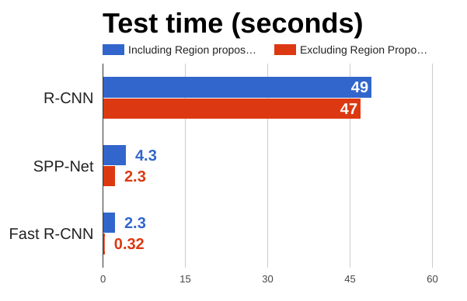
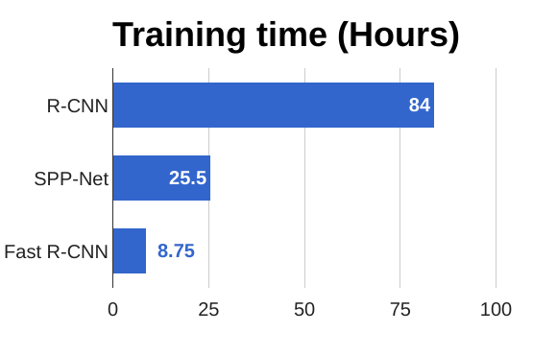
Fast R-CNN vs “Slow” R-CNN
Girshick et al, “Rich feature hierarchies for accurate object detection and semantic segmentation”, CVPR 2014. He et al, “Spatial pyramid pooling in deep convolutional networks for visual recognition”, ECCV 2014 Girshick, “Fast R-CNN”, ICCV 2015

Slide 92
Fast R-CNN vs “Slow” R-CNN
Problem: Runtime dominated by region proposals!
Girshick et al, “Rich feature hierarchies for accurate object detection and semantic segmentation”, CVPR 2014. He et al, “Spatial pyramid pooling in deep convolutional networks for visual recognition”, ECCV 2014 Girshick, “Fast R-CNN”, ICCV 2015

Slide 93
Fast R-CNN vs “Slow” R-CNN
Problem: Runtime dominated by region proposals!
Recall: Region proposals computed by
heuristic ”Selective Search” algorithm on CPU -- let’s learn them with a CNN instead!
Girshick et al, “Rich feature hierarchies for accurate object detection and semantic segmentation”, CVPR 2014. He et al, “Spatial pyramid pooling in deep convolutional networks for visual recognition”, ECCV 2014 Girshick, “Fast R-CNN”, ICCV 2015
Lecture 15 - 94

Slide 94
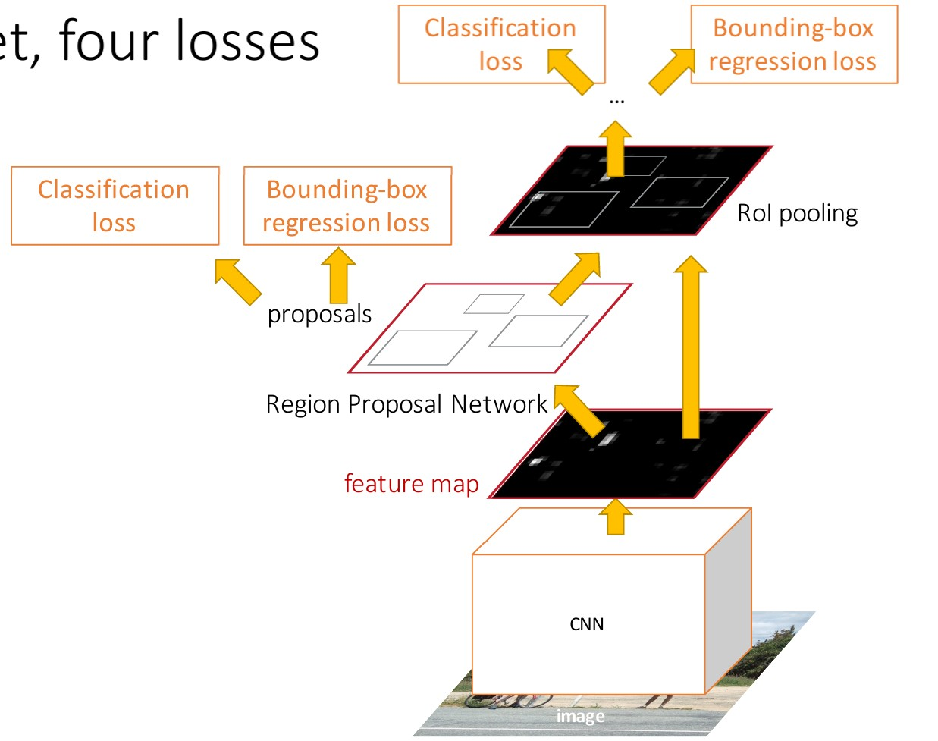
Faster R-CNN: Learnable Region Proposals
Insert Region Proposal Network (RPN) to predict proposals from features
Otherwise same as Fast R-CNN: Crop features for each proposal, classify each one
Ren et al, “Faster R-CNN: Towards Real-Time Object Detection with Region Proposal Networks”, NIPS 2015 Figure copyright 2015, Ross Girshick; reproduced with permission

Slide 95

Region Proposal Network (RPN)
Run backbone CNN to get features aligned to input image
CNN
Input Image (e.g. 3 x 640 x 480)
Image features (e.g. 512 x 20 x 15)

Slide 96
Imagine an anchor box of fixed size at each point in the feature map
Region Proposal Network (RPN)
Run backbone CNN to get features aligned to input image
CNN
Input Image (e.g. 3 x 640 x 480)
Image features
(e.g. 512 x 20 x 15)

Slide 97
Imagine an anchor box of fixed size at each point in the feature map
Region Proposal Network (RPN)
Run backbone CNN to get features aligned to input image
Anchor is an object?
1 x 20 x 15
CNN
Conv
At each point, predict whether the corresponding anchor contains an object (per-cell logistic regression, predict scores with conv layer)
Input Image (e.g. 3 x 640 x 480)
Image features
(e.g. 512 x 20 x 15)

Slide 98
Imagine an anchor box of fixed size at each point in the feature map
Region Proposal Network (RPN)
Run backbone CNN to get features aligned to input image
Anchor is an object?
1 x 20 x 15
CNN
Conv
Box transforms 4 x 20 x 15
Input Image (e.g. 3 x 640 x 480)
For positive boxes, also predict a box transform to regress from anchor box to object box
Image features (e.g. 512 x 20 x 15)

Slide 99
Region Proposal Network (RPN)
Problem: Anchor box may have the wrong size / shape Solution: Use K different anchor boxes at each point!
Run backbone CNN to get features aligned to input image
Anchor is an object?
K x 20 x 15
CNN
Conv
Box transforms
4K x 20 x 15
At test time: sort all K*20*15 boxes by their score, and take the top ~300 as our region proposals
Input Image (e.g. 3 x 640 x 480)
Image features (e.g. 512 x 20 x 15)
Lecture 15 - 100

Slide 100
Faster R-CNN: Learnable Region Proposals
Jointly train with 4 losses:
RPN classification: anchor box is object / not an object
RPN regression: predict transform from anchor box to proposal box
Object classification: classify proposals as background / object
class
Object regression: predict transform from proposal box to object box
Ren et al, “Faster R-CNN: Towards Real-Time Object Detection with Region Proposal Networks”, NIPS 2015 Figure copyright 2015, Ross Girshick; reproduced with permission

Slide 101
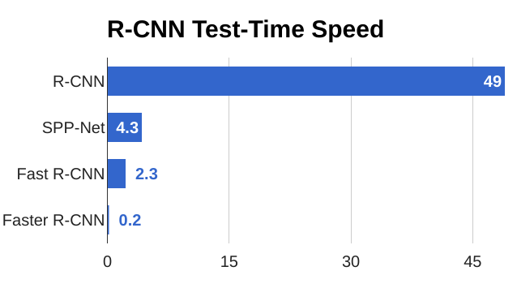
Faster R-CNN: Learnable Region Proposals

Slide 102
Faster R-CNN: Learnable Region Proposals
Faster R-CNN is a
Two-stage object detector
First stage: Run once per image
Backbone network
Region proposal network
Second stage: Run once per region
Crop features: RoI pool / align
Predict object class
Prediction bbox offset

Slide 103
Faster R-CNN: Learnable Region Proposals
Question: Do we really need the second stage?
Faster R-CNN is a
Two-stage object detector
First stage: Run once per image
Backbone network
Region proposal network
Second stage: Run once per region
Crop features: RoI pool / align
Predict object class
Prediction bbox offset

Slide 104
Single-Stage Object Detection
RPN: Classify each anchor as object / not object
Single-Stage Detector: Classify each object as one of C
Run backbone CNN to get
features aligned to input image
categories (or background)
Anchor category (C+1) x K x 20 x 15
CNN
Conv
Box transforms 4K x 20 x 15
Input Image (e.g. 3 x 640 x 480)
Remember: K anchors at each position in image feature map
Image features (e.g. 512 x 20 x 15)

Slide 105
Single-Stage Object Detection
RPN: Classify each anchor as object / not object
Single-Stage Detector: Classify each object as one of C
Run backbone CNN to get
features aligned to input image
categories (or background)
Anchor category (C+1) x K x 20 x 15
CNN
Conv
Box transforms
C x 4K x 20 x 15
Sometimes use category- specific regression: Predict different box transforms for each category
Input Image (e.g. 3 x 640 x 480)
Image features (e.g. 512 x 20 x 15)
Redmon et al, “You Only Look Once: Unified, Real-Time Object Detection”, CVPR 2016 Liu et al, “SSD: Single-Shot MultiBox Detector”, ECCV 2016
Lin et al, “Focal Loss for Dense Object Detection”, ICCV 2017

Slide 106
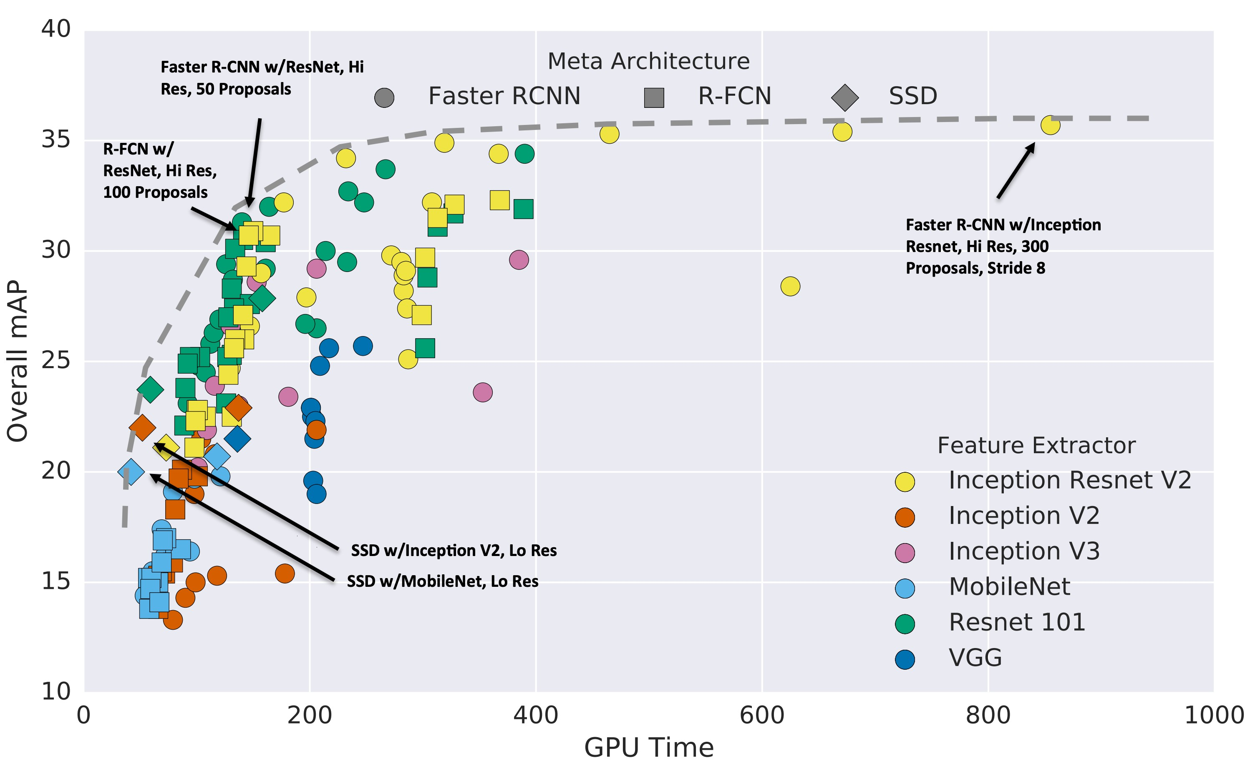
Object Detection: Lots of variables!
Huang et al, “Speed/accuracy trade-offs for modern convolutional object detectors”, CVPR 2017

Slide 107
Object Detection: Lots of variables!
Takeaways:
- Two stage method (Faster R-CNN) get the best accuracy, but are slower
Huang et al, “Speed/accuracy trade-offs for modern convolutional object detectors”, CVPR 2017

Slide 108
Object Detection: Lots of variables!
Takeaways:
Two stage method (Faster R-CNN) get the best accuracy, but are slower
Single-stage methods (SSD) are much faster, but
don’t perform as well
Huang et al, “Speed/accuracy trade-offs for modern convolutional object detectors”, CVPR 2017

Slide 109
Object Detection: Lots of variables!
Takeaways:
Two stage method (Faster R-CNN) get the best accuracy, but are slower
Single-stage methods (SSD) are much faster, but
don’t perform as well
Bigger backbones improve
performance, but are slower
Huang et al, “Speed/accuracy trade-offs for modern convolutional object detectors”, CVPR 2017
Lecture 15 - 110

Slide 110
Object Detection: Lots of variables!
Takeaways:
Two stage method (Faster R-CNN) get the best accuracy, but are slower
Single-stage methods (SSD) are much faster, but
don’t perform as well
Bigger backbones improve
performance, but are slower
Diminishing returns for
slower methods
Huang et al, “Speed/accuracy trade-offs for modern convolutional object detectors”, CVPR 2017
Lecture 15 - 111

Slide 111
Object Detection: Lots of variables!
These results are a few years old … since then GPUs have gotten faster, and we’ve improved performance with many tricks:
Huang et al, “Speed/accuracy trade-offs for modern convolutional object detectors”, CVPR 2017
Wu et al, Detectron2, GitHub 2019

Slide 112
Object Detection: Lots of variables!
These results are a few years old … since then GPUs have gotten faster, and we’ve improved performance with many tricks:
Train longer!
Multiscale backbone: Feature Pyramid Networks
Faster R-CNN w/ResNet-101-FPN, longer training (63ms, 42.0 mAP)
Huang et al, “Speed/accuracy trade-offs for modern convolutional object detectors”, CVPR 2017
Wu et al, Detectron2, GitHub 2019

Slide 113
Object Detection: Lots of variables!
These results are a few years old … since then GPUs have gotten faster, and we’ve improved performance with many tricks:
Train longer!
Multiscale backbone: Feature Pyramid Networks
Better backbone: ResNeXt
Faster R-CNN w/ResNet-101-FPN, longer training
Faster R-CNN w/ResNeXt-101-
(63ms, 42.0 mAP)
FPN, longer training (120ms, 43.0 mAP)
Huang et al, “Speed/accuracy trade-offs for modern convolutional object detectors”, CVPR 2017
Wu et al, Detectron2, GitHub 2019

Slide 114
Object Detection: Lots of variables!
These results are a few years old … since then GPUs have gotten faster, and we’ve improved performance with many tricks:
Train longer!
Multiscale backbone: Feature Pyramid Networks
Better backbone: ResNeXt
Single-Stage methods have improved
RetinaNet (SSD-like) w/ResNet-101 (80ms, 39.9 mAP)
Huang et al, “Speed/accuracy trade-offs for modern convolutional object detectors”, CVPR 2017
Wu et al, Detectron2, GitHub 2019

Slide 115
Object Detection: Lots of variables!
Mask R-CNN w/RexNeXt-152 (281 ms, 49.3 mAP)
These results are a few years old … since then GPUs have gotten faster, and we’ve improved performance with many tricks:
Train longer!
Multiscale backbone: Feature Pyramid Networks
Better backbone: ResNeXt
Single-Stage methods have improved
Very big models work better
Huang et al, “Speed/accuracy trade-offs for modern convolutional object detectors”, CVPR 2017
Wu et al, Detectron2, GitHub 2019

Slide 116
Object Detection: Lots of variables!
Mask R-CNN
These results are a few years old … since then GPUs have gotten faster, and we’ve improved performance with many tricks:
w/RexNeXt-152 (281 ms, 49.3 mAP)
Mask R-CNN w/RexNeXt-152
+Test-time augmentation
(? ms, 51.4 mAP)
Train longer!
Multiscale backbone: Feature Pyramid Networks
Better backbone: ResNeXt
Single-Stage methods have improved
Very big models work better
Test-time augmentation pushes numbers up
Huang et al, “Speed/accuracy trade-offs for modern convolutional object detectors”, CVPR 2017
Wu et al, Detectron2, GitHub 2019

Slide 117
Object Detection: Lots of variables!
Current leaderboard
winner: 55 mAP Method ???
Runtime ???
Mask R-CNN
These results are a few years old … since then GPUs have gotten faster, and we’ve improved performance with many tricks:
w/RexNeXt-152 (281 ms, 49.3 mAP)
Train longer!
Multiscale backbone: Feature Pyramid Networks
Better backbone: ResNeXt
Single-Stage methods have improved
Very big models work better
Test-time augmentation pushes numbers up
Big ensembles, more data, etc
Huang et al, “Speed/accuracy trade-offs for modern convolutional object detectors”, CVPR 2017
https://competitions.codalab.org/competitions/20794#results

Slide 118
Object Detection: Open-Source Code
Object detection is hard! Don’t implement it yourself (Unless you are working on A5…)
TensorFlow Detection API:
https://github.com/tensorflow/models/tree/master/research/object_detection Faster R-CNN, SSD, RFCN, Mask R-CNN
Detectron2 (PyTorch):
https://github.com/facebookresearch/detectron2 Fast / Faster / Mask R-CNN, RetinaNet

Slide 119
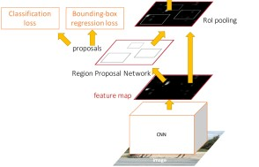


Summary
“Slow” R-CNN: Run CNN independently for each region
Fast R-CNN: Apply differentiable cropping to shared
Faster R-CNN: Compute proposals with CNN
Single-Stage: Fully convolutional detector
Bbox |  | Class
image features
Bbox
Class
Bbox
Class
Conv Net
Forward each region through ConvNet
Warped image regions (224x224)
Conv Net
Bbox |  | Bbox |  | Bbox
Class |  | Class |  | Class
Category and box transform per region
Conv Net
Regions of Interest (RoIs) from a proposal method
Per-Region Network
CNN
CNN
CNN
Crop + Resize features Image features
Run whole image through ConvNet
Input image
Regions of Interest (RoI) from a proposal method (~2k)
“Backbone” network: AlexNet, VGG, ResNet, etc
ConvNet
Input image
Lecture 15 - 120

